Slide 1

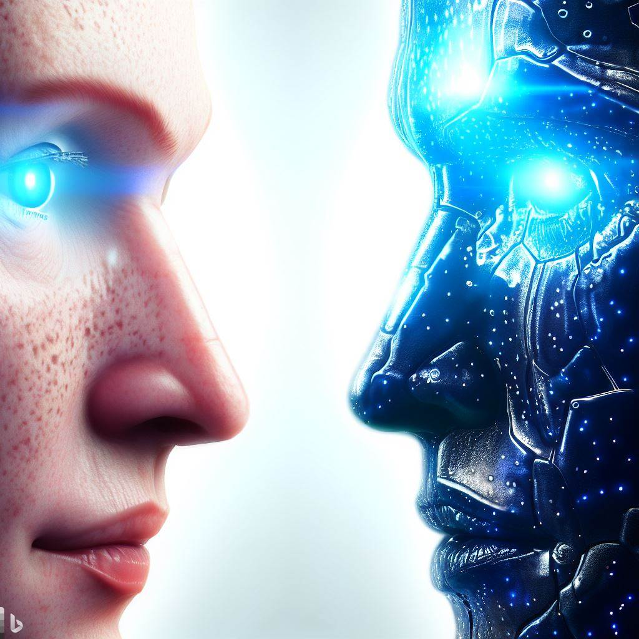
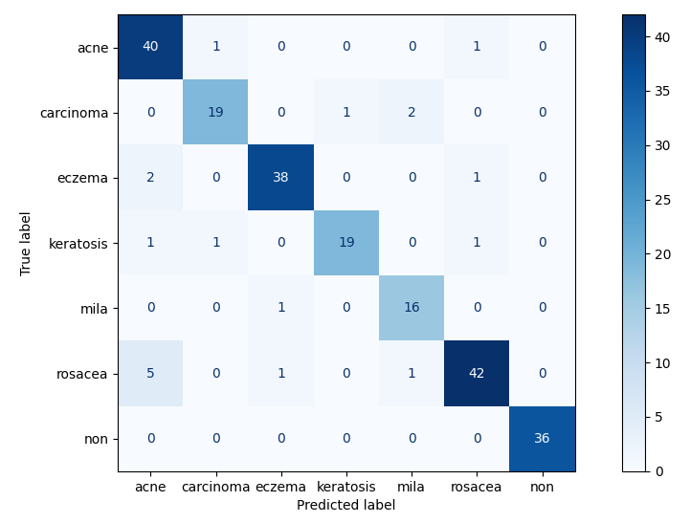
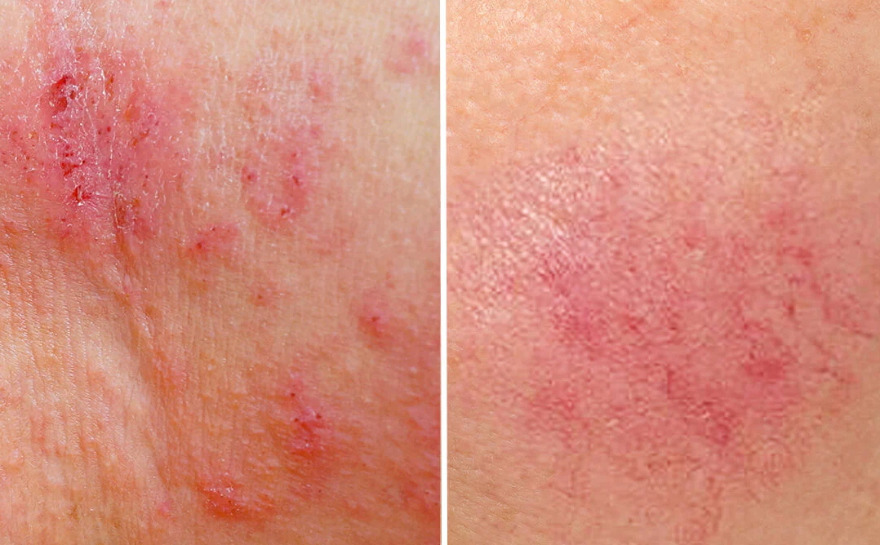
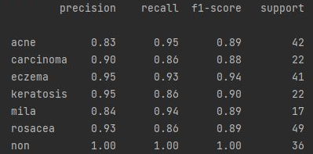








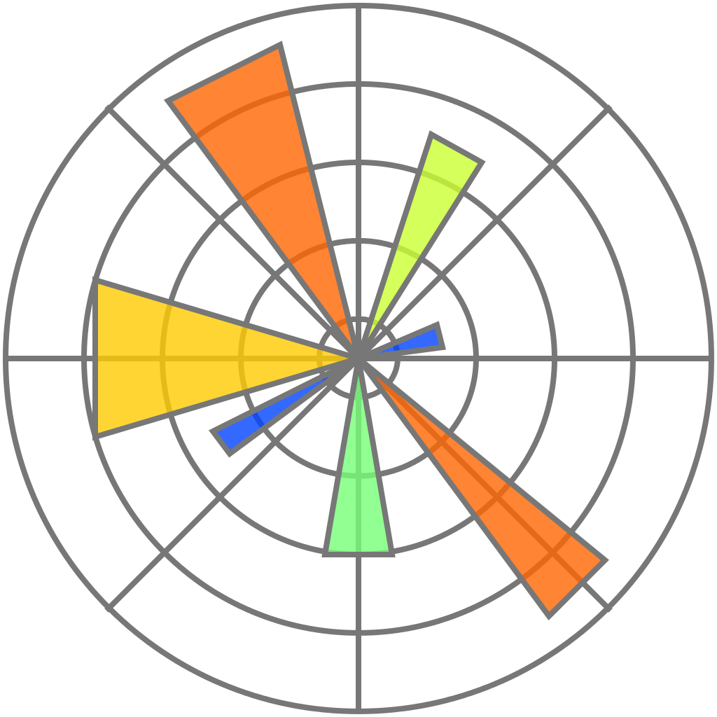



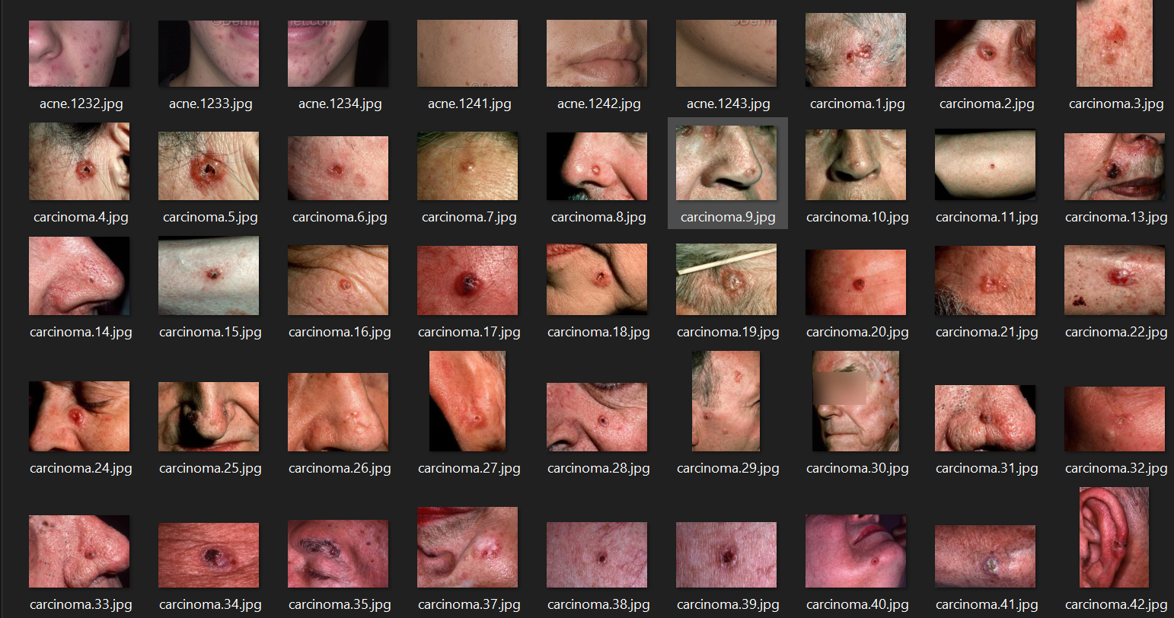

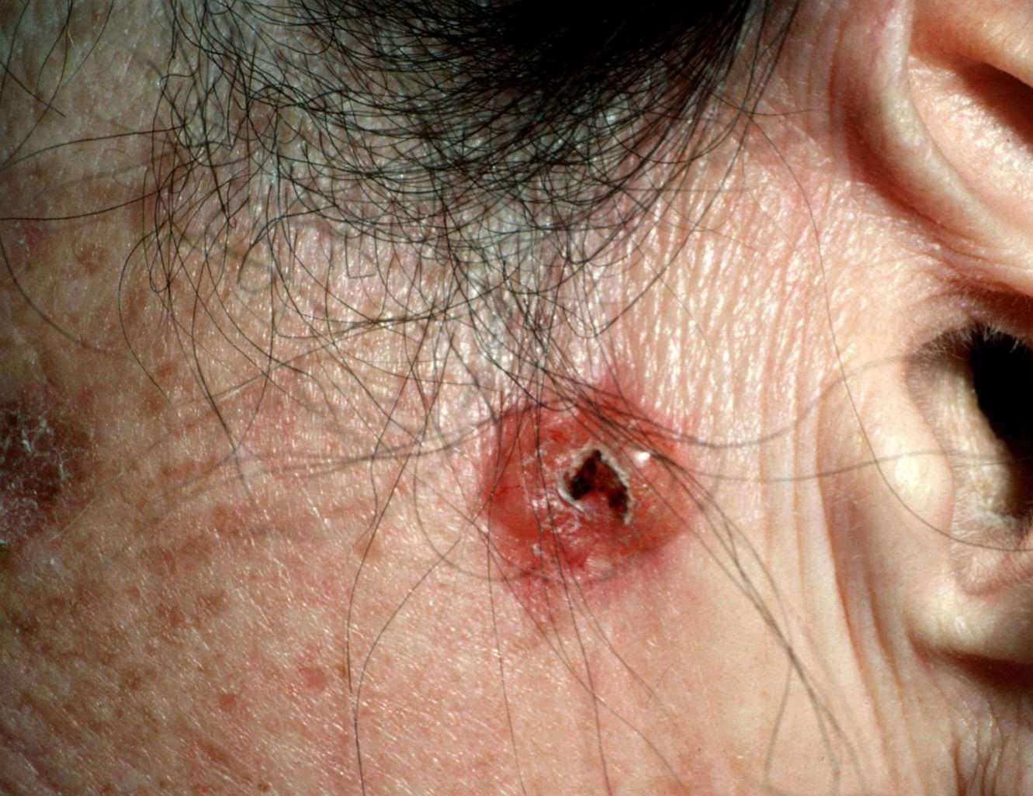
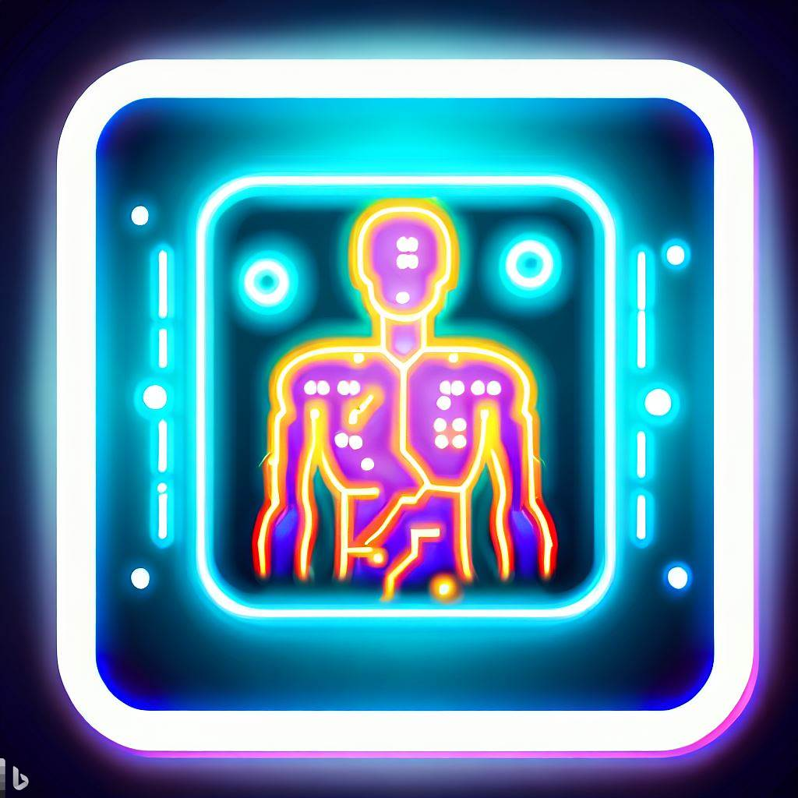


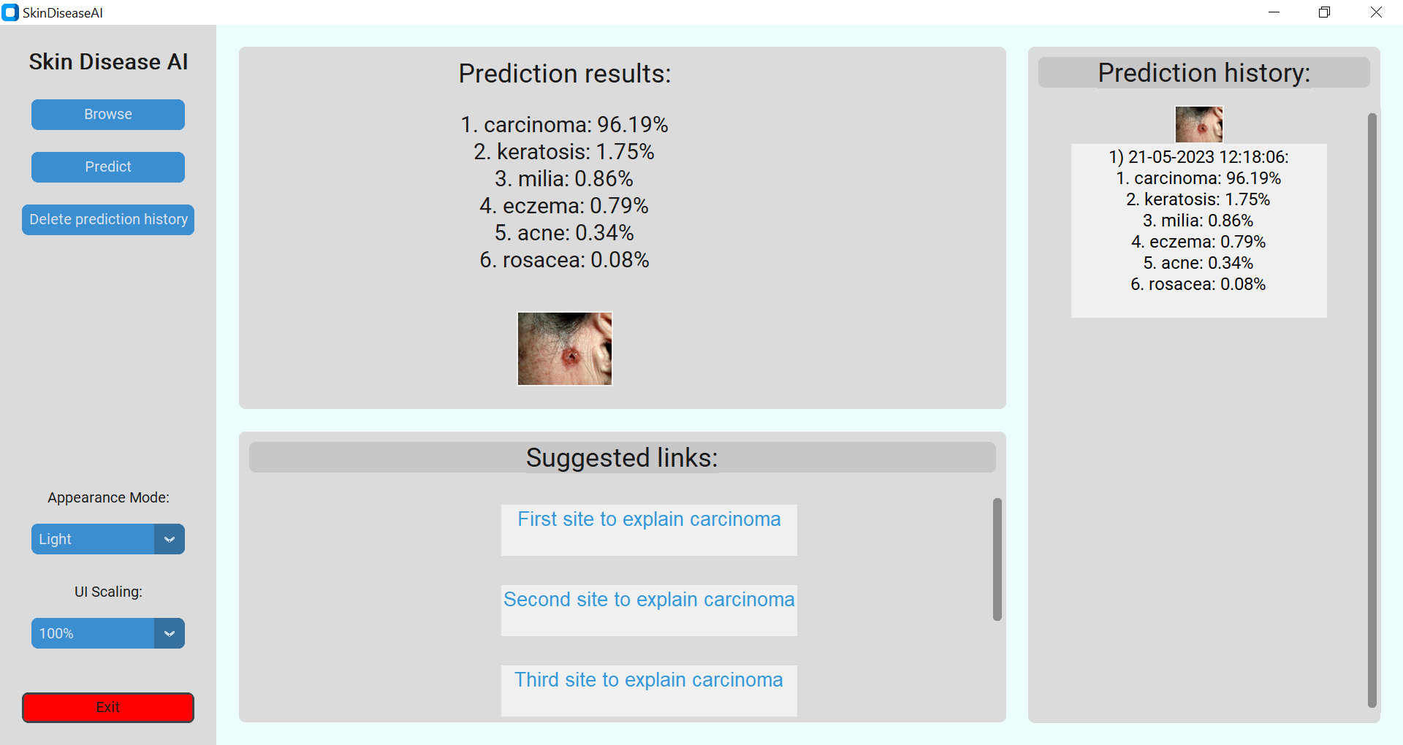


P_ID 65
Teledermatologis AI
Automated Diagnosis of Skin Diseases with Image Recognition
Authors:
Nadav Ishai, Dolev Peretz, Natalia Vanetik, Marina Litvak
Best result:
92% accuracy for Xception.
Confusion Matrix
Contributions:
1. Dataset
1,657 images of 7 classes:
Acne
Carcinoma
Eczema
Keratosis
Milia
Rosacea
Non skin-lesion
Rigorous process followed to gather the dataset:
Images acquired from various sources.
Duplicates and poor quality images removed.
Each image annotated with correct label.
2. Experiments with multiple models
Experimented with various classification algorithms:
KNN
Naïve Bayes
Decision Tree
Random Forest
We found that these algorithms did not achieve desired level of accuracy, so we shifted focus to deep learning models and tested five Keras models:
Sequential
InceptionV3
Xception
EfficientNetV2L
ConvNeXtBase
After extensive experimentation and fine-tuning:
Xception model provided best performance.
Accurately classified six types of skin lesions in our dataset.
3. PC application
Runs locally.
Doesn't require an internet connection.
Allows users to browse for a photo of a skin lesion.
Predicts the type of skin lesion present in the image.
Keeps a prediction history.
4. Online website
Securely hosted on HTTPS protocol to protect user data.
Accessible from anywhere with an internet connection.
Ensures privacy and data security by not saving images or prediction history.
Our model successfully recognizes and distinguishes between Eczema and Rosacea which are too similar, but distinct skin conditions. Witness how our model excels in precise classification to ensure accurate diagnosis and treatment.
Eczema
Rosacea
Results per class
In this classification report, you'll notice that our model's precision, recall, and F1-score for the 'non-skin lesion' class all stand at a perfect 1 out of 1. This remarkable performance signifies that our model accurately recognizes and classifies images devoid of any skin lesions.
Our Motivation
Making diagnosis is a difficult task for dermatologists.
Diagnosis accuracy is crucial for treatment success.
Leveraging technology to solve real-world health problems.
Our project aims to build a system for automatic diagnosis using:
Neural network model
User-friendly interface
Machine learning
Image processing analysis
Enhancing Model Performance: Future Endeavors
Diversify Training Data: Expanding the dataset in terms of size and diversity to capture a wider range of real-world cases.
Fine-Tune Hyperparameters: Delve into the optimization of learning rates and network architectures for fine-grained control over model behavior.
Augmenting Data: Implement advanced data augmentation techniques, including random cropping, flipping, rotation, and adding noise to images, to enhance model robustness and adaptability.
Broaden Lesion Classification: Extend the model's capabilities to encompass a wider range of skin lesions.
Technologies we utilized:
Our project pipeline:
Train
Traditional classification algorithms: KNN, Naïve Bayes, Decision Tree and Random Forest.
Classification model
Image
preprocessing
Fine-tuning
Evaluate
Insufficient
results
Dataset
DNN
Input image
Carcinoma
Train
Explore the Project on GitHub & the Online Website
Image
preprocessing
Deep neural network models: Sequential, InceptionV3, Xception, EfficientNetV2L and ConvNeXtBase
Best model
Preprocessing
Fine-tuning
Evaluate
Xception model
Deployment
PC app & website
Output
Prediction

